Slide 1
Why Best Practice Doesn’t Work In Practice The political challenge of anti-corruption Anh Le IED Intern aql3@duke.edu

Slide 2
challenges

Slide 3
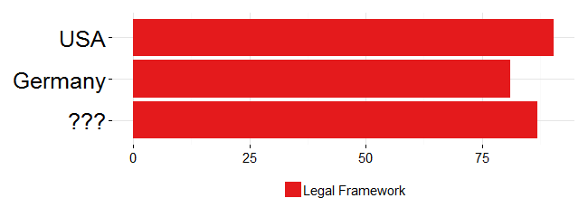
Let’s guess this Asian country
Source: Global Integrity Report (2011)
Notes:
Scoring anti-corruption legal framework of 31 countries

Slide 4
Not Hong Kong
Not Singapore

Slide 5
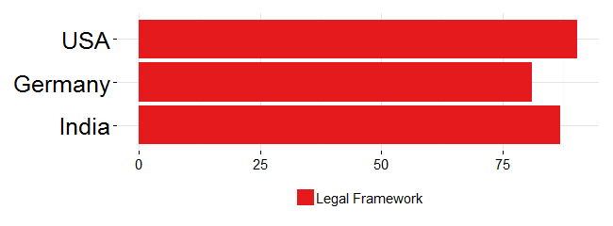
It’s . . .
Source: Global Integrity Report (2011)
Notes:
perfect anti-corruption law, which criminalizes bribery, extortion, and misuse of public assets
a host of supporting institutions, including a national ombudsman protected by law against political interference
an independent agency with the legal mandate to address corruption, whose leader can only be removed by the head of a democratically elected government based on an inquiry by the Supreme Court

Slide 6
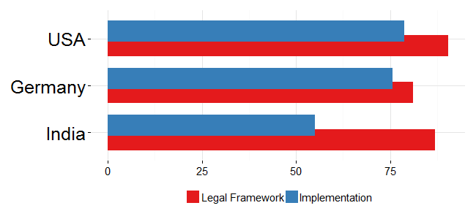
Here is a fuller picture
Source: Global Integrity Report (2011)

Slide 7
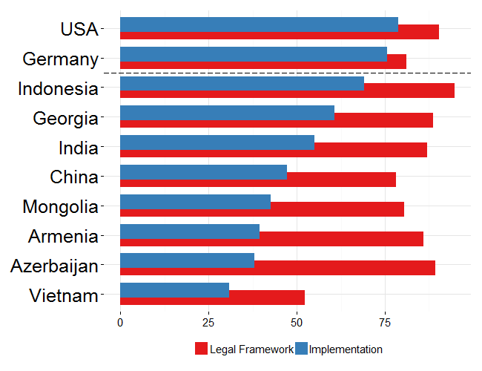
An even fuller picture
Source: Global Integrity Report (2011)
Notes:
All countries have a legal framework comparable to that of OECD countries
However, implementation is universally worse in ADB member countries, with the exception of Indonesia being a moderate success
KEY: our effort does pay off – look at the red bars – the corruption persists, and the problem is in the blue bars.

Slide 8
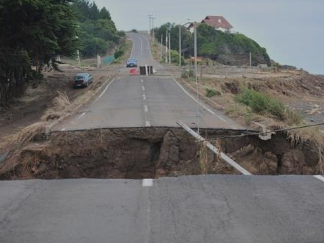
Challenge #1: Implementation gap
Notes:
Lacking political will is the foremost reasons of implementation gap
Resource may be an issue, but it’s often the allocation, the dedication of resource that is the problem, not the overall resource available (ADB’s loan are small compared to countries’ resources anyway)

Slide 9
Challenge #1: Implementation gap
“…budgets are better made than executed, practice lags behind the creation of processes and laws.”
(Andrews 2010)
Notes:
Lacking political will is the foremost reasons of implementation gap
Resource may be an issue, but it’s often the allocation, the dedication of resource that is the problem, not the overall resource available (ADB’s loan are small compared to countries’ resources anyway)

Slide 10
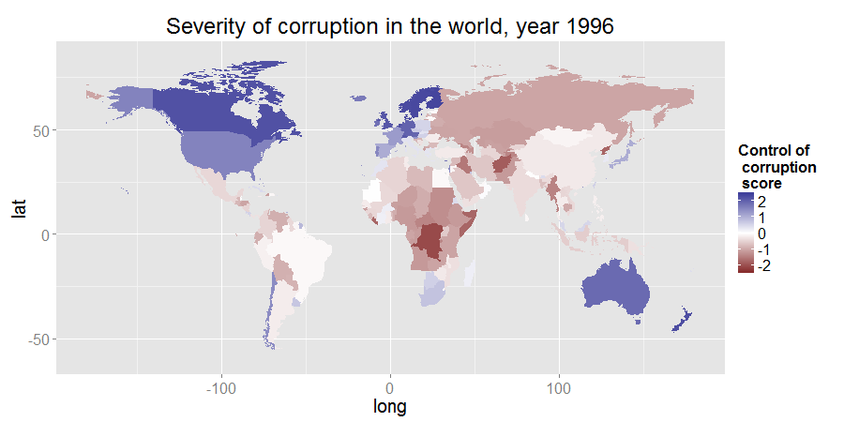
Source: World Governance Index

Slide 11
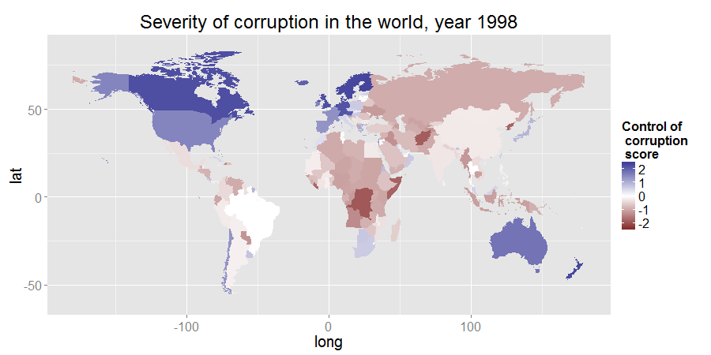
Source: World Governance Index

Slide 12
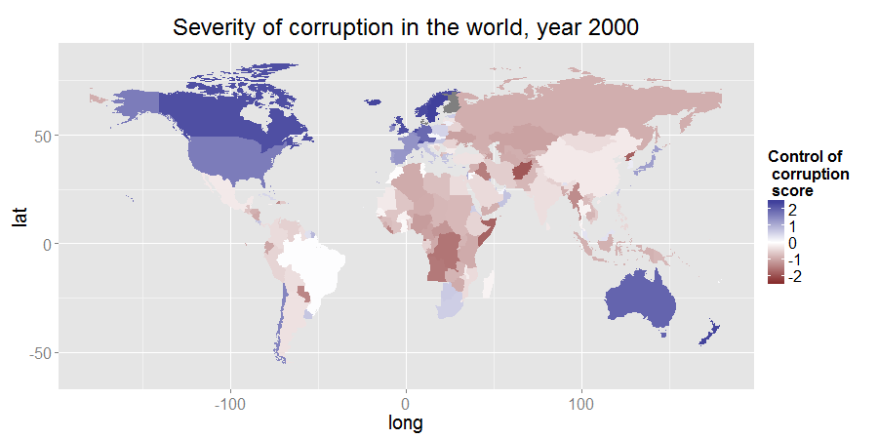
Source: World Governance Index

Slide 13
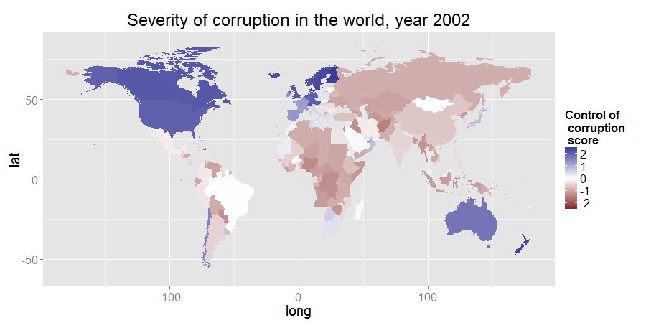
Source: World Governance Index

Slide 14
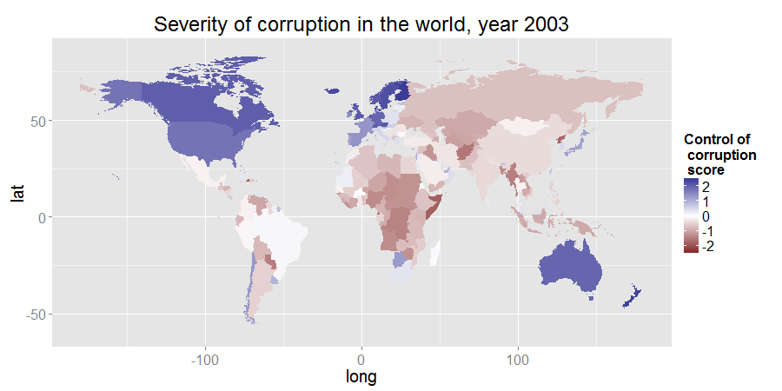
Source: World Governance Index

Slide 15
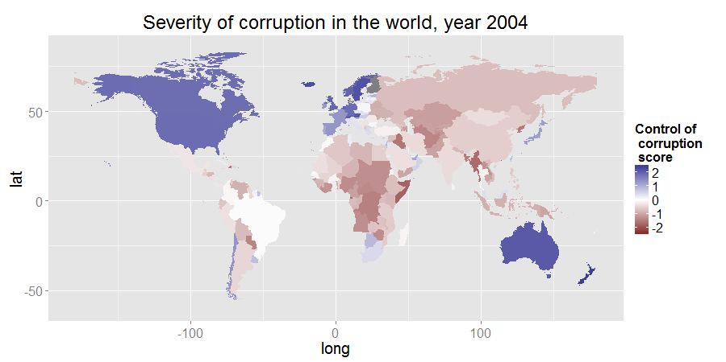
Source: World Governance Index

Slide 16
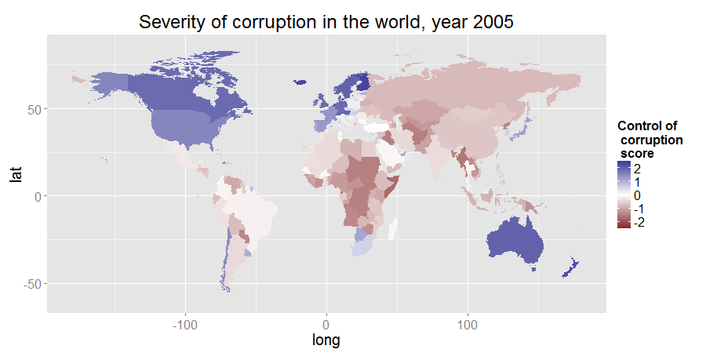
Source: World Governance Index

Slide 17
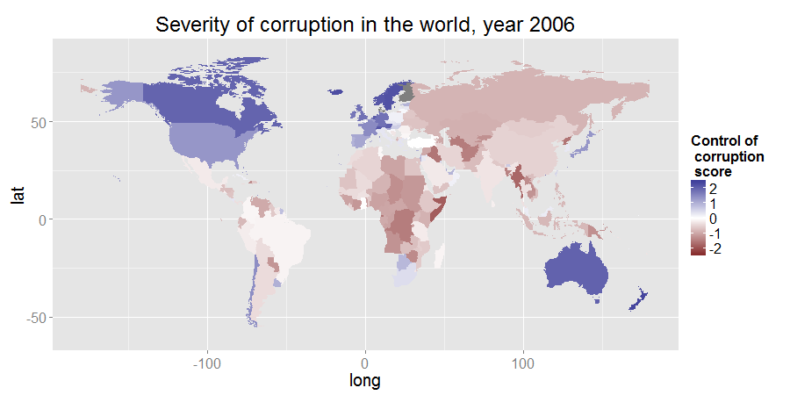
Source: World Governance Index

Slide 18
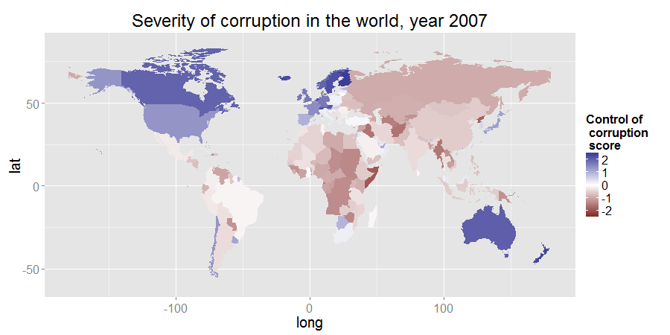
Source: World Governance Index

Slide 19

Source: World Governance Index

Slide 20
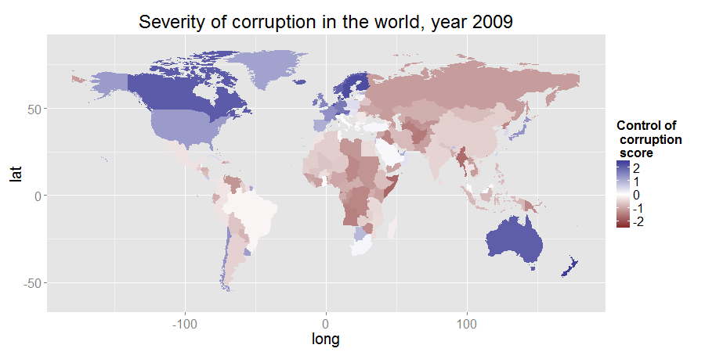
Source: World Governance Index

Slide 21

Source: World Governance Index

Slide 22

Source: World Governance Index

Slide 24
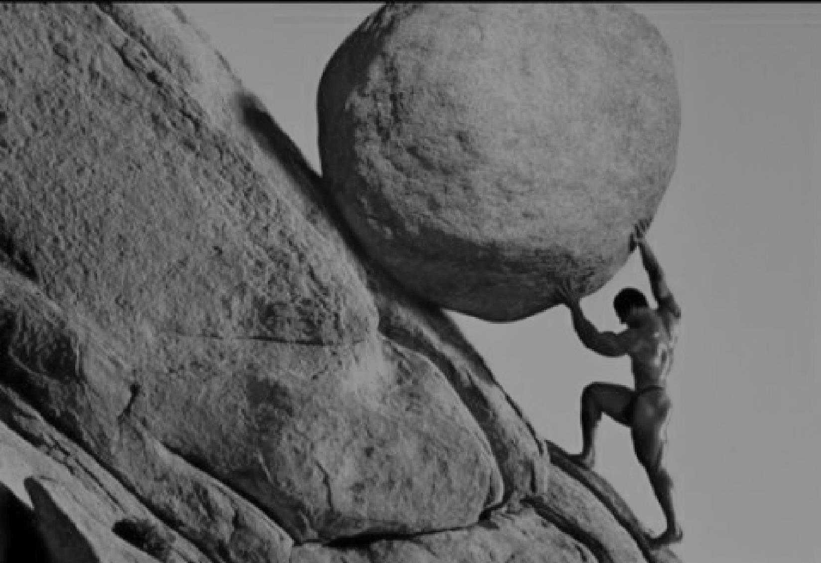
Challenge #2:
Reform reversal

Slide 25
Challenge #2:
Reform reversal
“… the weak states would take hundreds, if not thousands, of years to acquire state capability.”
(Pritchett et al. 2010)

Slide 26
Notes:
- Our effort did pay off. Laws did get passed. Modern bureaucratic processes and institutions did get created. So we are successful, but only in the sense that improved laws but not improved lives is a success, and that development after hundreds of years is good enough.

Slide 27
Why?
Why?
Notes:
But as committed organization and passionate professionals, of course that’s not good enough for us. At this point, we are burning with the question “Why?”

Slide 28
explanation
Notes:
The short answer, as hinted above, is lacking political will
I will provide a more satisfying answer of why political will is important for anti-corruption, and why our current thinking is underprepared to deal with this problem

Slide 29
Supply-side initiative
Demand-side initiative

Slide 30
Supply side initiative

Slide 31
Supply side initiative
Principal-agent

Slide 32
Supply side initiative
Principal-agent
Collective action
Notes:
The left is easy—we just need to provide the tool and the best model, which we have
Breaking the network on the right is very hard

Slide 33

Isomorphic mimicry –
“adopting the camouflage of organizational forms that are successful elsewhere to hide their actual dysfunction.”
(Pritchett et al. 2010)
Notes:
1) Agencies like ADB have great influence over the form—the law making, the process—but little over the function, the implementation, which is very hard to monitor. Without seeing there is no influencing.
2) Attempt to actually influencing the function of the organization will touch upon the real, the material interest of officials. It is no longer just things on paper, and thus there will be much greater resistance.

Slide 34
Two of ADB’s anti-corruption tools: TA and policy-based lending
Principal-agent
Notes:
To be fair, these initiatives do consider political will
But it takes existing political will as a given and do what’s possible
It does not try to nurture political will, leaving the bottleneck intact

Slide 35
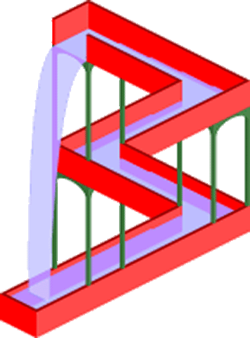
GACAP II:

Slide 36
GACAP II: Good anti-corruption practice in ADB’s projects will not necessarily travel upstream to the country level.

Slide 37
Demand side initiative

Slide 38
Demand side initiative
Principal-agent

Slide 39
Demand side initiative
Principal-agent
Collective action

Slide 40

Italy –

Slide 41
Italy – “… judicial allegations of serious wrongdoing proved of little importance to reelection probabilities.”
(Chang et al. 2007)

Slide 42
Vietnam –

Slide 43
Vietnam – “… nothing would change old ways.”
(Duong 2007)

Slide 44

Results from Randomized Controlled Trials
India –
Notes:
- Providing information and the institution of participation alone is not sufficient. (mobilization actually succeeded, many people attend meetings to discuss the local educational system / volunteer to teach)

Slide 45
Results from Randomized Controlled Trials
India – “Parents may be too pessimistic about their ability to influence the system even if they are willing to take an active role…”
(Banerjee 2010)
Notes:
- Providing information and the institution of participation alone is not sufficient. (mobilization actually succeeded, many people attend meetings to discuss the local educational system / volunteer to teach)

Slide 46
Results from Randomized Controlled Trials
Indonesia –

Slide 47
Results from Randomized Controlled Trials
Indonesia – “… grass-roots monitoring may be most effective when a subset of people personally stand to gain from reducing corruption, and therefore have strong incentives to monitor actively.”
(Olken 2005)

Slide 48
so what?

Slide 49
We need to build political will …

Slide 50
We need to build political will …
but politics is messy

Slide 51
action

Slide 52
Indicators and Benchmarks (IB)
Notes:
Example: Let’s say that we collect data on the expenditure on standard medical equipment. We find that hospital A routinely spends 20% more than market price, hospital B spends about the same, and hospital C manages to spend less.

Slide 53
Indicators and Benchmarks (IB)
Performance audit across peer units
Notes:
Example: Let’s say that we collect data on the expenditure on standard medical equipment. We find that hospital A routinely spends 20% more than market price, hospital B spends about the same, and hospital C manages to spend less.

Slide 54
Indicators and Benchmarks (IB)
Performance audit across peer units
Repeated, publicized, actionable
Notes:
- We may do the same data collection on other dimensions of performance. We then widely publish the result, visibly commend high performance units, and repeat the exercise annually. As the results accumulate over years, we can focus more on comparing a unit with its past performance rather than with its peers.

Slide 55
Indicators and Benchmarks (IB)
Performance audit across peer units
Repeated, publicized, actionable
Immediate impact on people’s welfare
Notes:
That kind of diagnostics has value in and of itself, because it points to bottlenecks of governance, shows us where attention is needed most.
But furthermore, back to our concern with political will, this strategy can also arouse the public interest

Slide 56

Tip each individual’s cost-benefit balance into joining our cause

Slide 57
Indicators
Quality of infrastructure
Expense on standard goods
Time for routine process

Slide 58
Benchmarks
BEST: A unit’s own past performance
Norm in other units
Private sector
Statistical model

Slide 59
IB and ADB

Slide 60

How IB fits ADB
Cordial relationship with government

Slide 61
How IB fits ADB
Cordial relationship with government
Routinized implementation

Slide 62
How IB fits ADB
Cordial relationship with government
Routinized implementation
Technical capacity

Slide 63
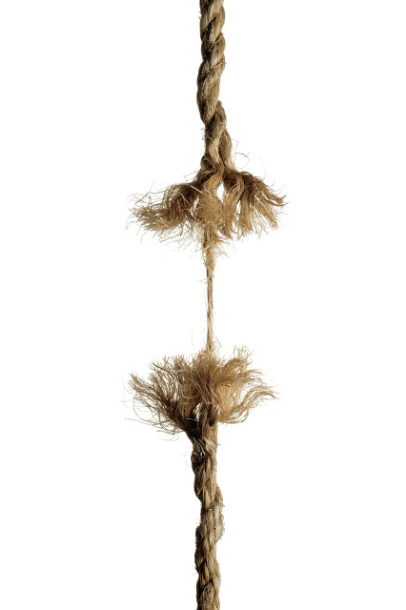
ADB’s areas for improvement: Political economy analysis & Deep country knowledge

Slide 64
word of caution

Slide 65
Change the mindset,
not the tool

Slide 66
thank you

